Slide 1
Happy New Year
Welcome Back

Slide 2
STUDENT SUCCESS, TEXTBOOK AFFORDABILITY, And Your Prospective SSTA LIBRARIAN
Jeremy D. Lucas
Jeremy D. Lucas

Slide 3
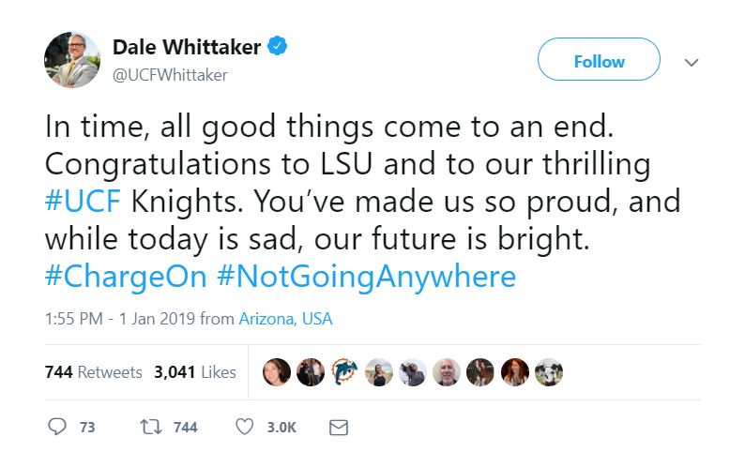

Slide 4
OVER THE HOLIDAY BREAK, I…
Started a Book, but Didn’t Finish It
Started a Book and Finished It
Bought a Book or Two or More
STUDENT SUCCESS & TEXTBOOK AFFORDABILITY
LIBRARIAN

Slide 5
IN 2018, I…
Underlined or Highlighted Text in a Book I Own
Wrote in the Margins of a Book I Own
Texted an Image of a Page in a Book I Own
STUDENT SUCCESS & TEXTBOOK AFFORDABILITY
LIBRARIAN

Slide 6
BUT LATELY, I…
Tend to Read Books on a Tablet/Phone/Device
Still Prefer Reading Physical Copies of a Book
Don’t Have Much Time for Leisure Reading
STUDENT SUCCESS & TEXTBOOK AFFORDABILITY
LIBRARIAN

Slide 7
WHEN I DO GET A CHANCE TO READ, I…
Need a Quiet Place. No Noise. No People.
Don’t Mind the Distractions. It’s All Music to Me.
Have a Specific Place I Like to Sit/Lay/Stand.
Am Content Anywhere. The Place Doesn’t Matter.
STUDENT SUCCESS & TEXTBOOK AFFORDABILITY
LIBRARIAN

Slide 8
Mark Palmer, Ronan deKervenoael, Dimitry Jacob “Temporary Institutional Breakdowns” Studies in Higher Education December 2018
"While a textbook may be physically the same for everyone, what is read is a different experience for every individual, depending on what they bring into it and how they use it and connect it with their own lives."
STUDENT SUCCESS & TEXTBOOK AFFORDABILITY
LIBRARIAN

Slide 9
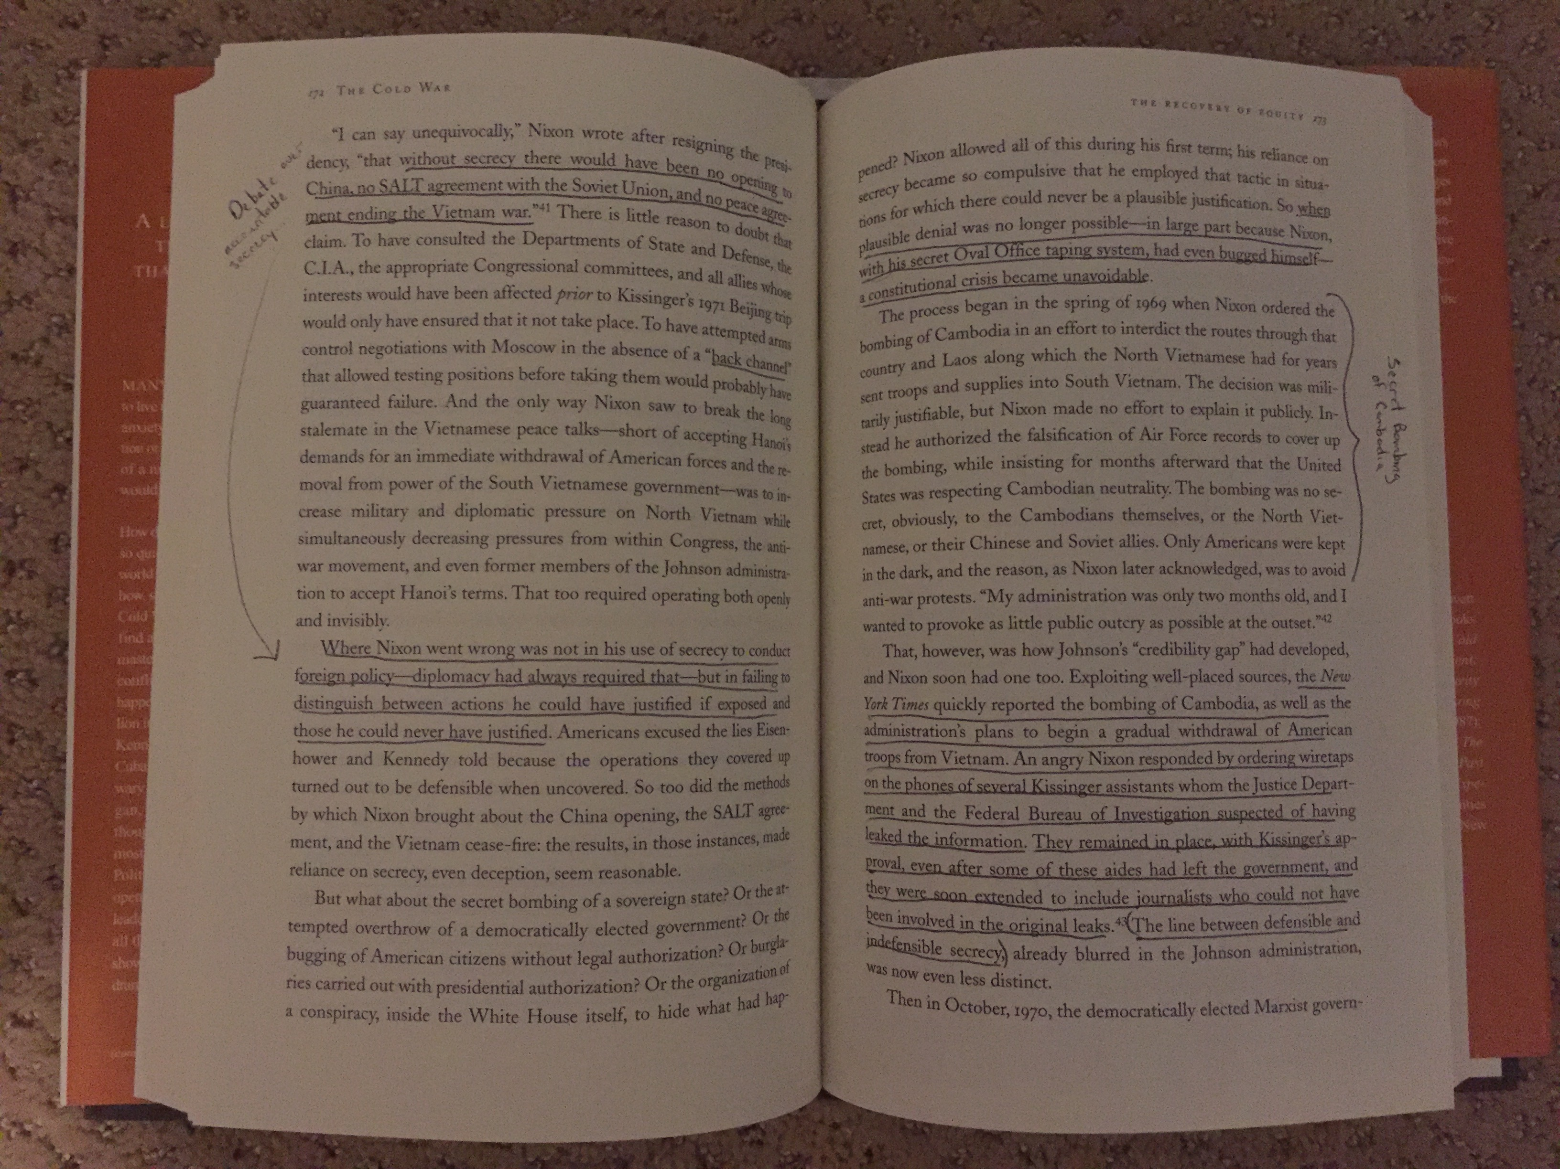
STUDENT SUCCESS & TEXTBOOK AFFORDABILITY
LIBRARIAN

Slide 10
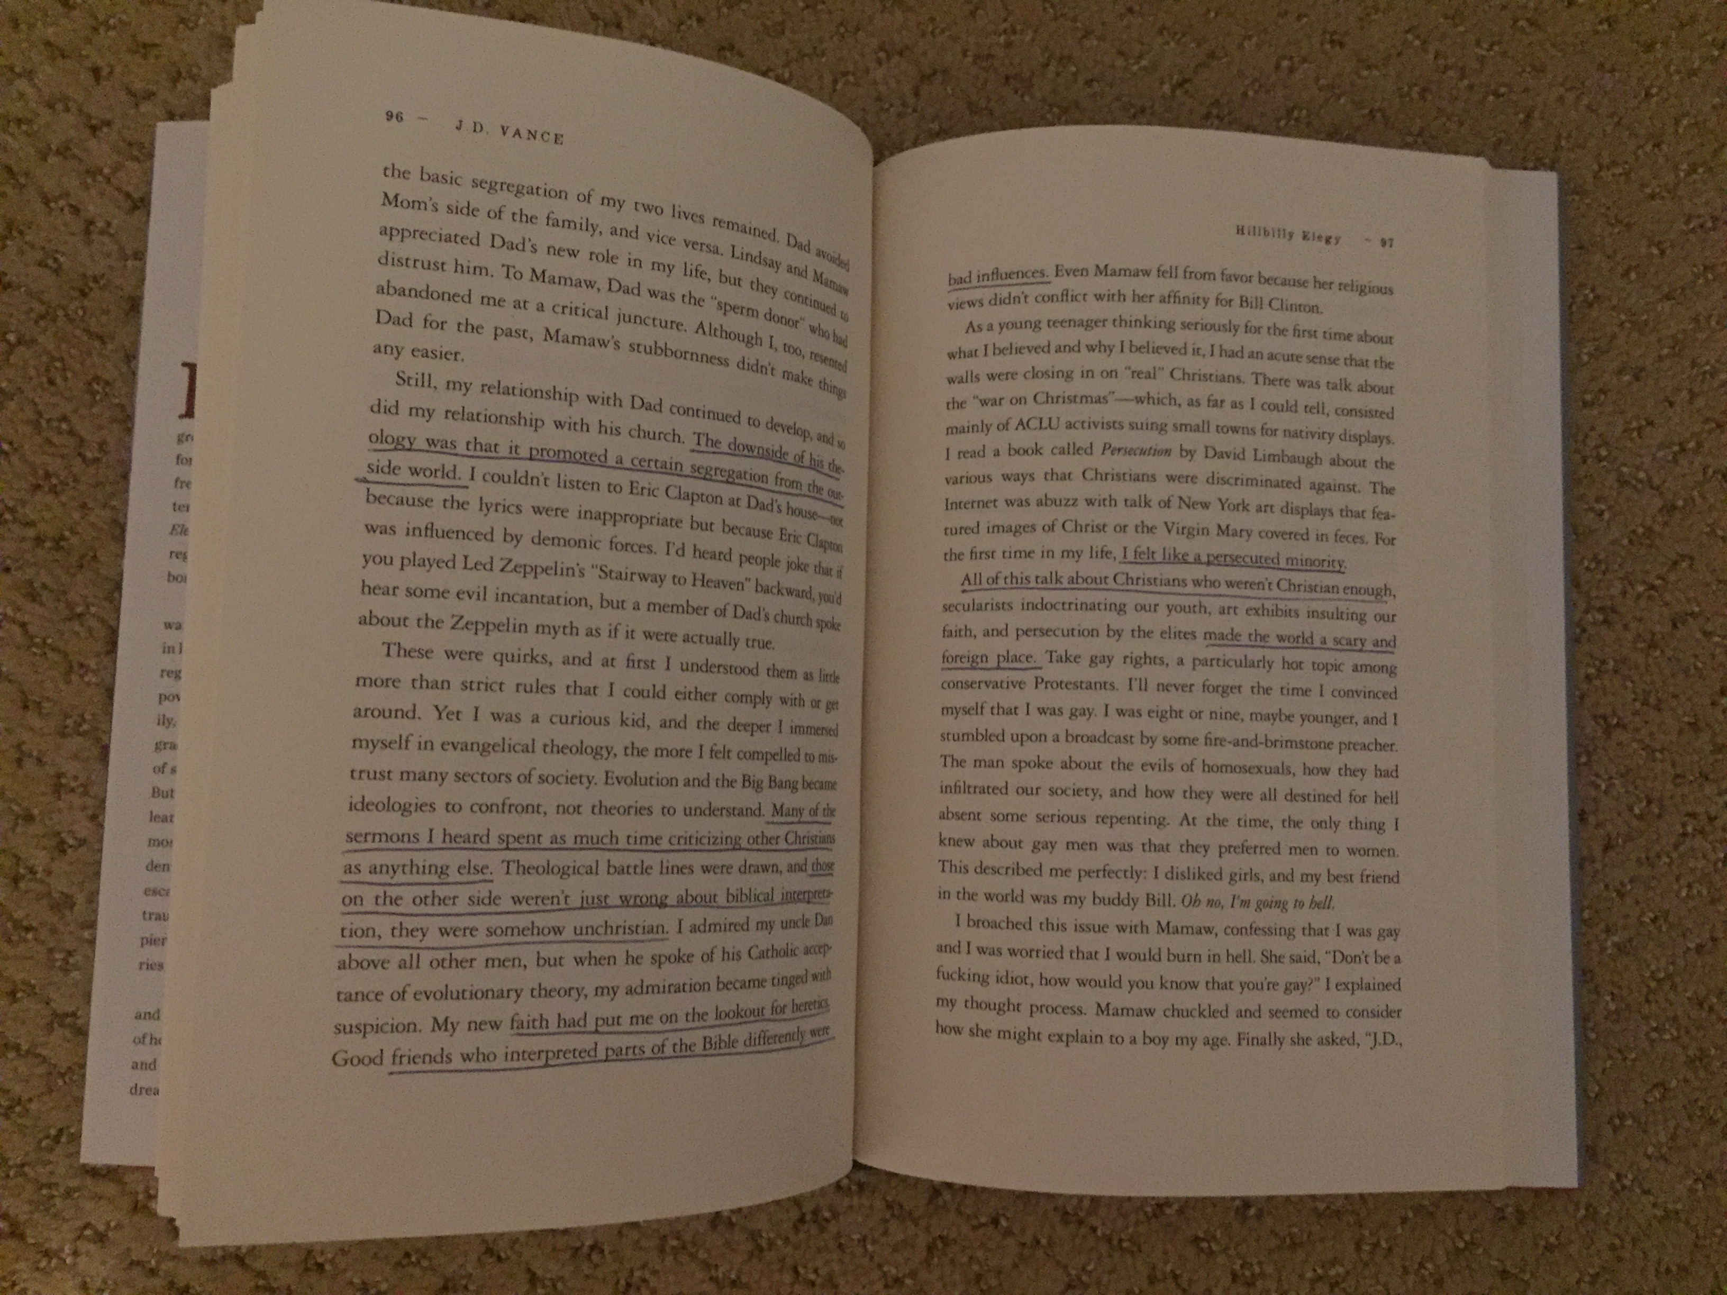
STUDENT SUCCESS & TEXTBOOK AFFORDABILITY
LIBRARIAN

Slide 11
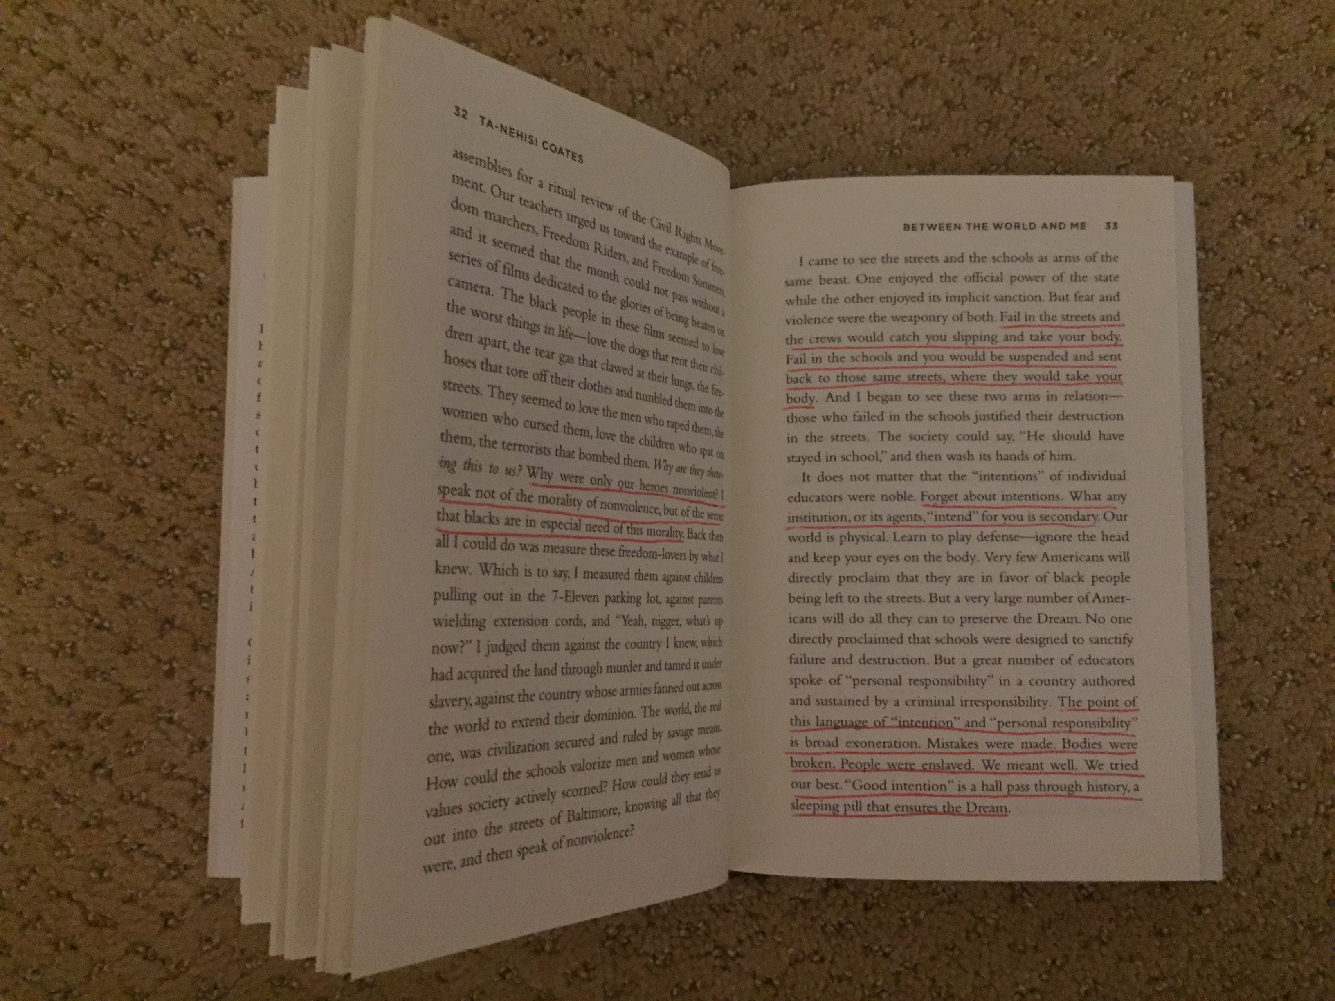
STUDENT SUCCESS & TEXTBOOK AFFORDABILITY
LIBRARIAN

Slide 12
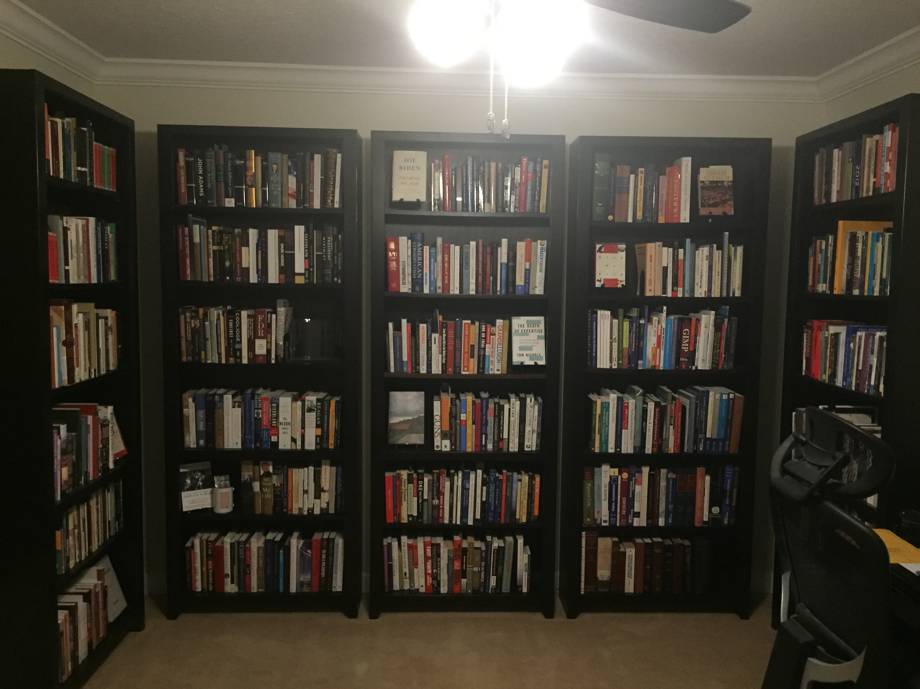
STUDENT SUCCESS & TEXTBOOK AFFORDABILITY
LIBRARIAN
The Things We Treasure Most

Slide 13
Melvil Dewey “Our Next Half-Century” Bulletin of the ALA, Vol. 20, No. 10
“Most librarians are inclined to make a book something sacred. But we ought to recognize and employ it as a tool... The public wants certain things done the way they can be done best, cheapest, and quickest, and if libraries can do this, then that is the proper function… Our great function is to inform
or to inspire, or to please."
STUDENT SUCCESS & TEXTBOOK AFFORDABILITY
LIBRARIAN
October 1926

Slide 14
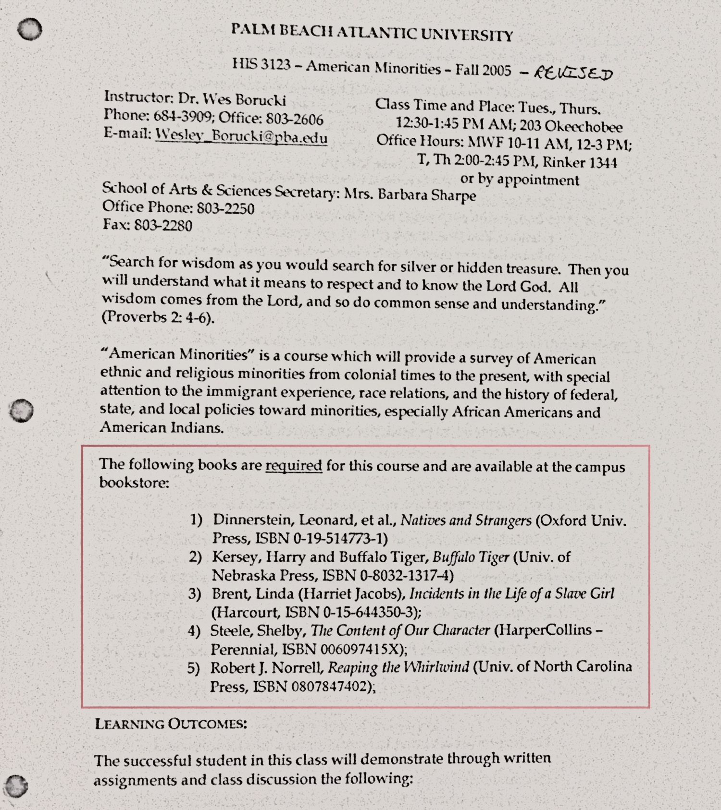
SO WHAT HAPPENS WHEN OUR STUDENTS SEE THE SYLLABUS FOR A CLASS AND NOTICE THEIR REQUIRED READING LIST?
STUDENT SUCCESS & TEXTBOOK AFFORDABILITY
LIBRARIAN
(I asked around)

Slide 15
STUDENT SUCCESS & TEXTBOOK AFFORDABILITY
LIBRARIAN

Slide 16
Judith Flanders “The British Library’s Action Plan” The Times Literary Supplement
“Every day the library is filled with, among others, people sleeping, students doing their homework, bright young things writing film scripts—in fact, doing almost anything except consulting the library’s books."
STUDENT SUCCESS & TEXTBOOK AFFORDABILITY
LIBRARIAN
September 2005

Slide 17
WHICH MEANS WHAT?
NUMBER ONE
The Library is Still Viewed as a Safe Space for Student Study
NUMBER TWO
The Library is No Longer the First Resource for Student Books
NUMBER THREE
A Relevant, Preeminent Library must Find a Way to Achieve Both
STUDENT SUCCESS & TEXTBOOK AFFORDABILITY
LIBRARIAN

Slide 18
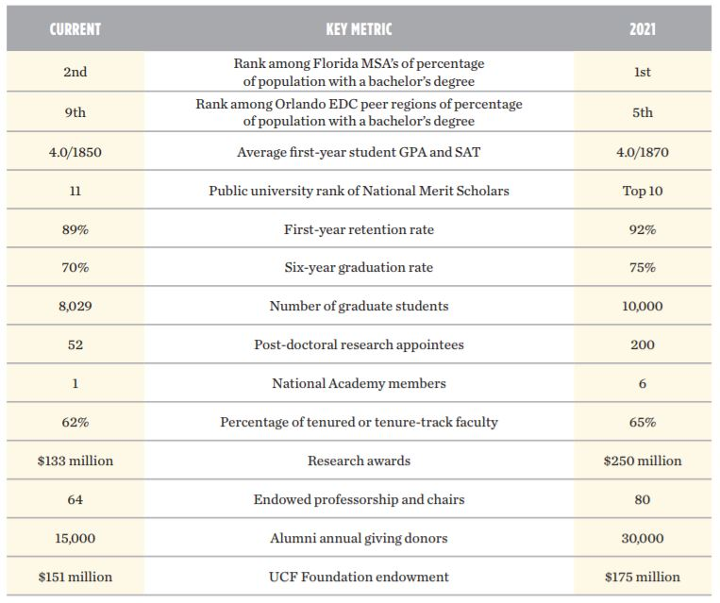
THE ROAD TO PREEMINENCE UCF Collective Impact Strategic Plan https://www.ucf.edu/wp-content/uploads/2012/08/UCF-Strategic-Plan-BOT-FINAL-052616-Web.pdf
STUDENT SUCCESS & TEXTBOOK AFFORDABILITY
LIBRARIAN

Slide 19
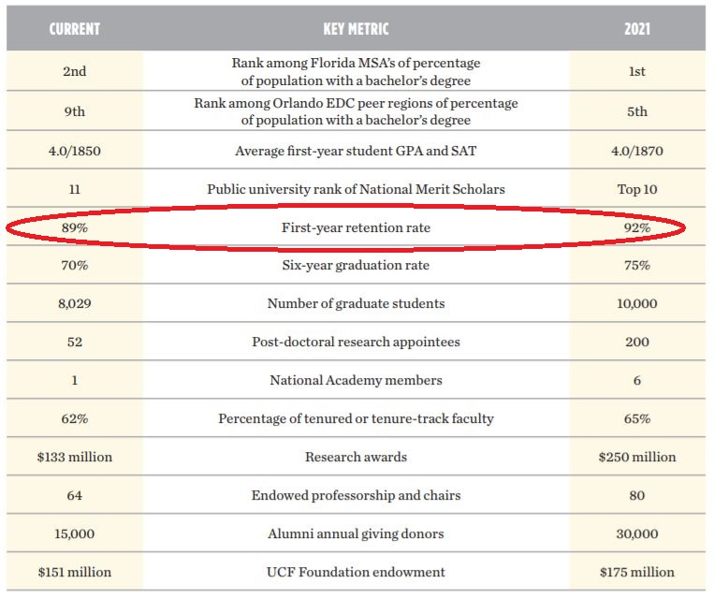
BEGINS WITH A GOOD FIRST IMPRESSION UCF Collective Impact Strategic Plan https://www.ucf.edu/wp-content/uploads/2012/08/UCF-Strategic-Plan-BOT-FINAL-052616-Web.pdf
STUDENT SUCCESS & TEXTBOOK AFFORDABILITY
LIBRARIAN

Slide 20
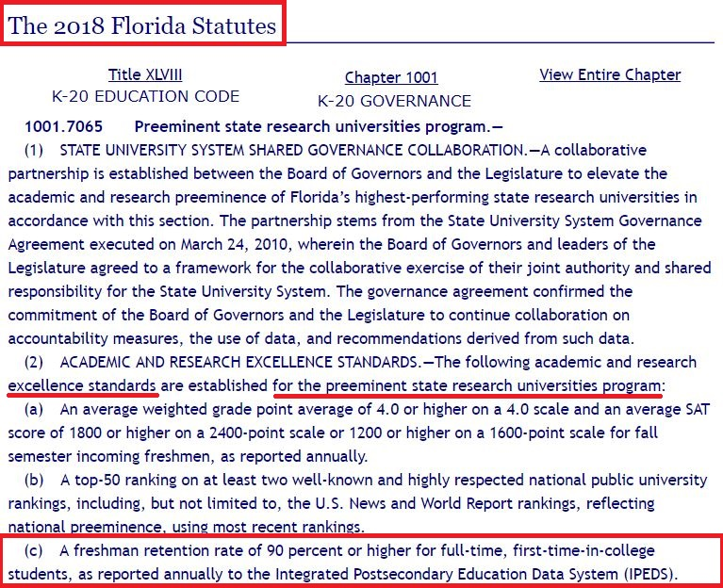
WE ONLY SUCCEED IF THEY SUCCEED 2018 Florida State Statutes http://www.leg.state.fl.us/Statutes/index.cfm?App_mode=Display_Statute&URL=1000-1099/1001/Sections/1001.7065.html
STUDENT SUCCESS & TEXTBOOK AFFORDABILITY
LIBRARIAN

Slide 21
2017-2018 FTIC Student Enrollment 39,223 FTIC Students Applied 19,454 FTIC Students were Accepted 7,383 FTIC Students Enrolled 6,674 FTIC Students Returned for 2018-2019 UCF Institutional Knowledge Management Fact Book & Admissions Data https://ikm.ucf.edu/files/2018/07/01.01-Admissions-Data-2017-18.pdf
2016-2017 FTIC Student Enrollment 36,136 FTIC Students Applied 18,074 FTIC Students were Accepted 6,901 FTIC Students Enrolled 6,183 FTIC Students Returned for 2017-2018 UCF Institutional Knowledge Management Fact Book & Admissions Data https://ikm.ucf.edu/files/2018/07/01.01-Admissions-Data-2017-18.pdf
STUDENT SUCCESS & TEXTBOOK AFFORDABILITY
LIBRARIAN

Slide 22
2016-2017 FTIC Student Enrollment
2017-2018 FTIC Student Enrollment
FTIC Retention
89.6%
FTIC Retention
90.4%
STUDENT SUCCESS & TEXTBOOK AFFORDABILITY
LIBRARIAN

Slide 23
“Reaching this key [retention] milestone underscores UCF’s strong commitment to student success and our dedication to become a leading preeminent university for the 21st century.” Elizabeth A. Dooley, November 2018 Provost/VP of Academic Affairs https://today.ucf.edu/retention-rate-new-ucf-students-hits-record-90-4/
STUDENT SUCCESS & TEXTBOOK AFFORDABILITY
LIBRARIAN

Slide 24
SSTA LIBRARIAN GOALS FOR CONTINUING STUDENT SUCCESS
GOAL #1
A strong cooperation with admissions to support students at risk of exit through focused outreach
GOAL #4
An accessible hub for textbook related inquiries (rentals, returns, policies) and training therein
GOAL #5
An ongoing analysis of textbook costs, savings, and related student achievement results/gaps
GOAL #2
A growing, receptive, pliant knowledge of all UCF course requirements and available materials
GOAL #3
An increase of trust between teaching faculty & subject librarians (student supported objectives)
GOAL #6
A lasting collaboration with outside vendors and relevant institutions (Open Access+)
STUDENT SUCCESS & TEXTBOOK AFFORDABILITY
LIBRARIAN

Slide 25
WHY SHOULD YOU CONSIDER ME AS YOUR SSTA LIBRARIAN
SO WHO AM I AND
STUDENT SUCCESS & TEXTBOOK AFFORDABILITY
LIBRARIAN

Slide 26
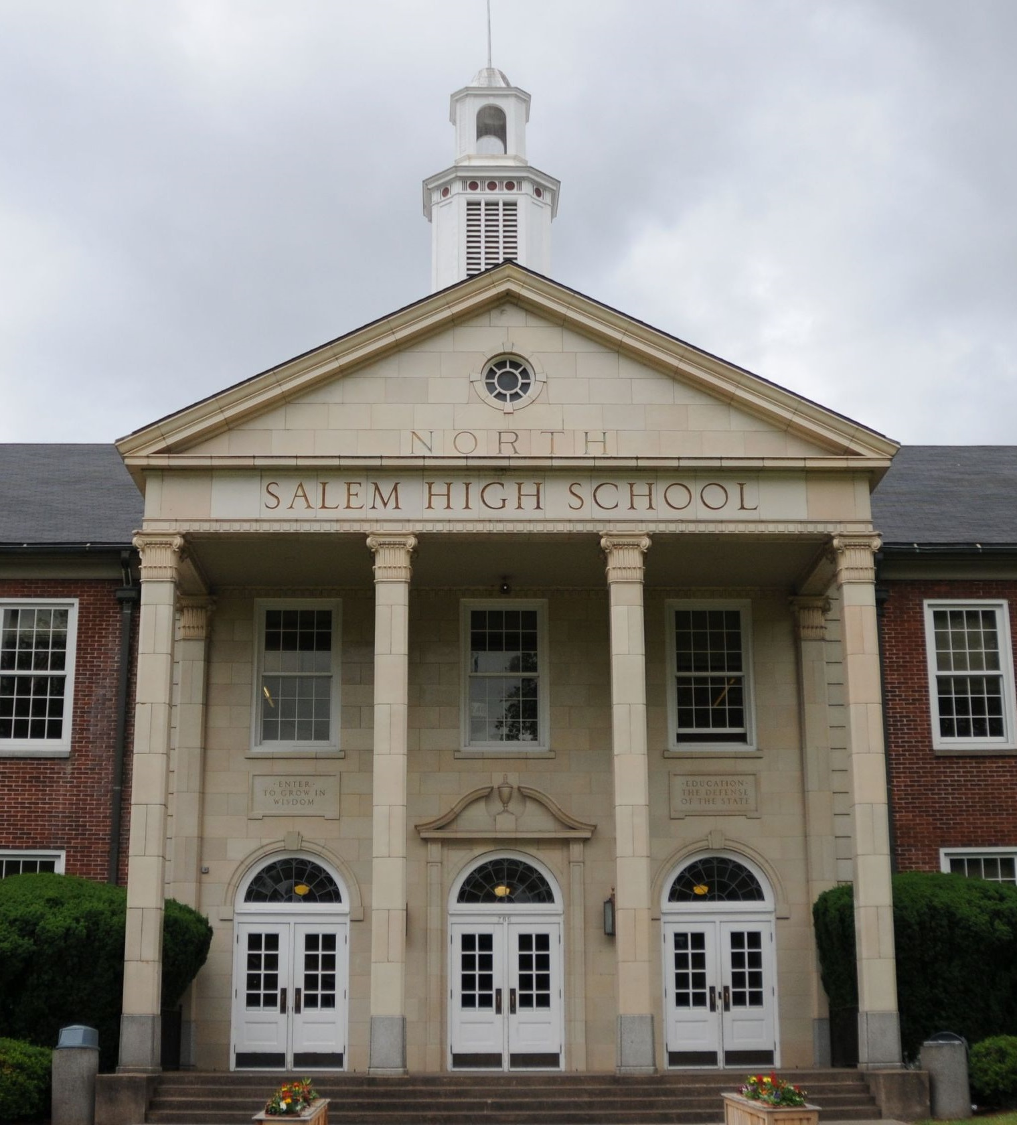
1992-1995* North Salem High School Salem, Oregon

Slide 27
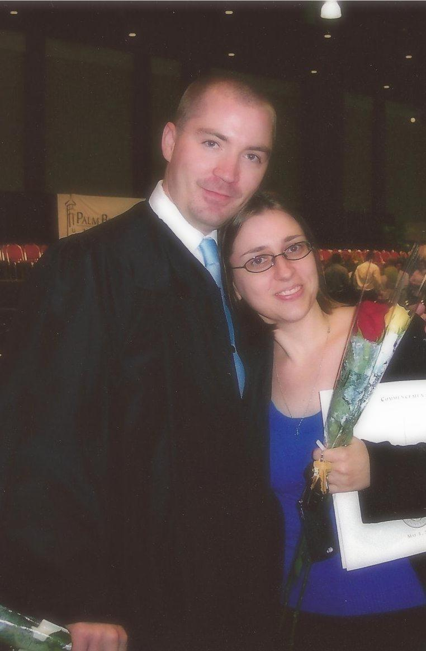
2005*-2008* Palm Beach Atlantic University West Palm Beach, Florida BA, History & Political Science

Slide 28
2009-2010
Researched, Wrote, and Published a Book on Social, Theological History
Worked as a Substitute Teacher in Martin County for all levels of K12
Trained Servers for PB CCF & Waited
for an Opportunity to Teach Full Time

Slide 29
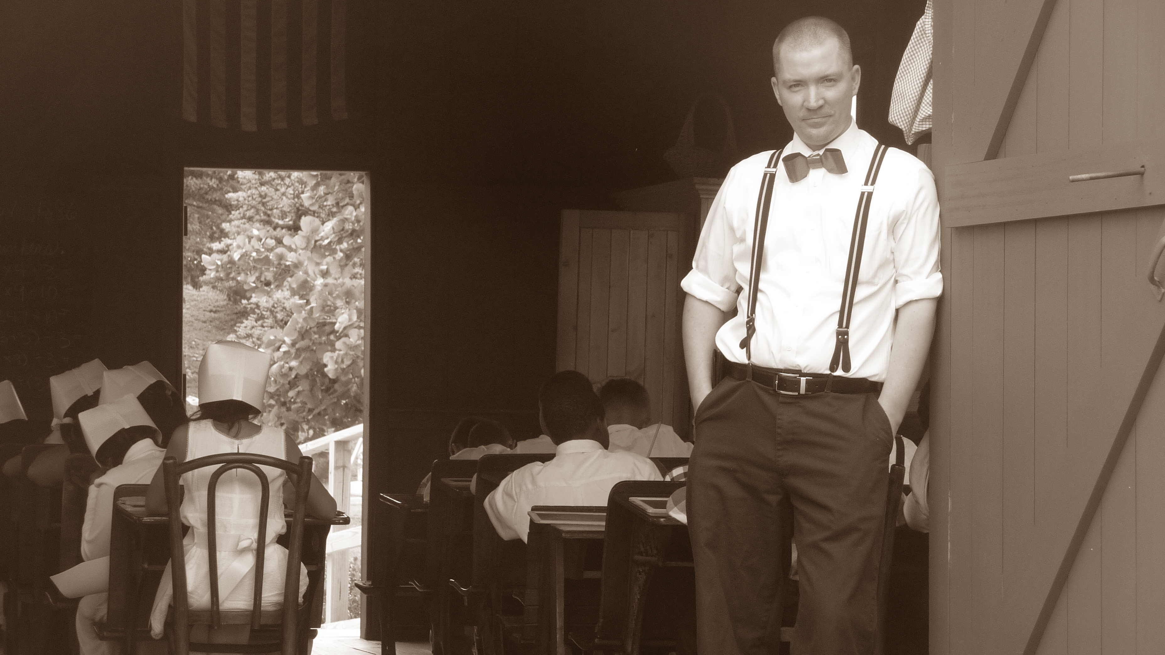
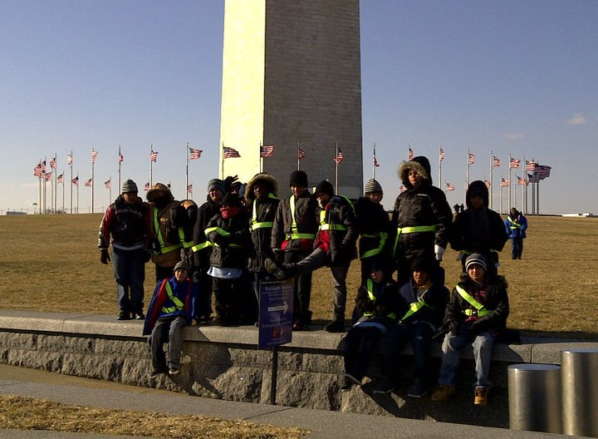
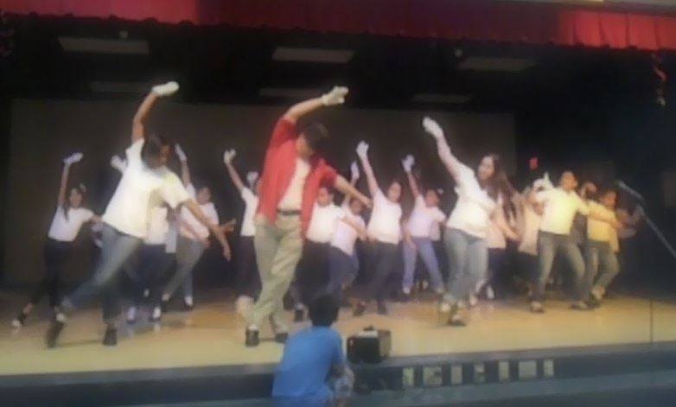
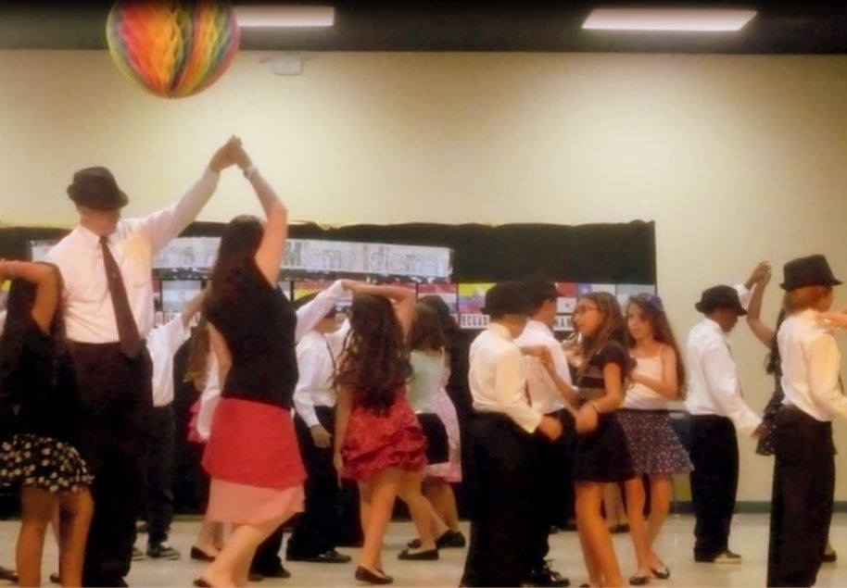
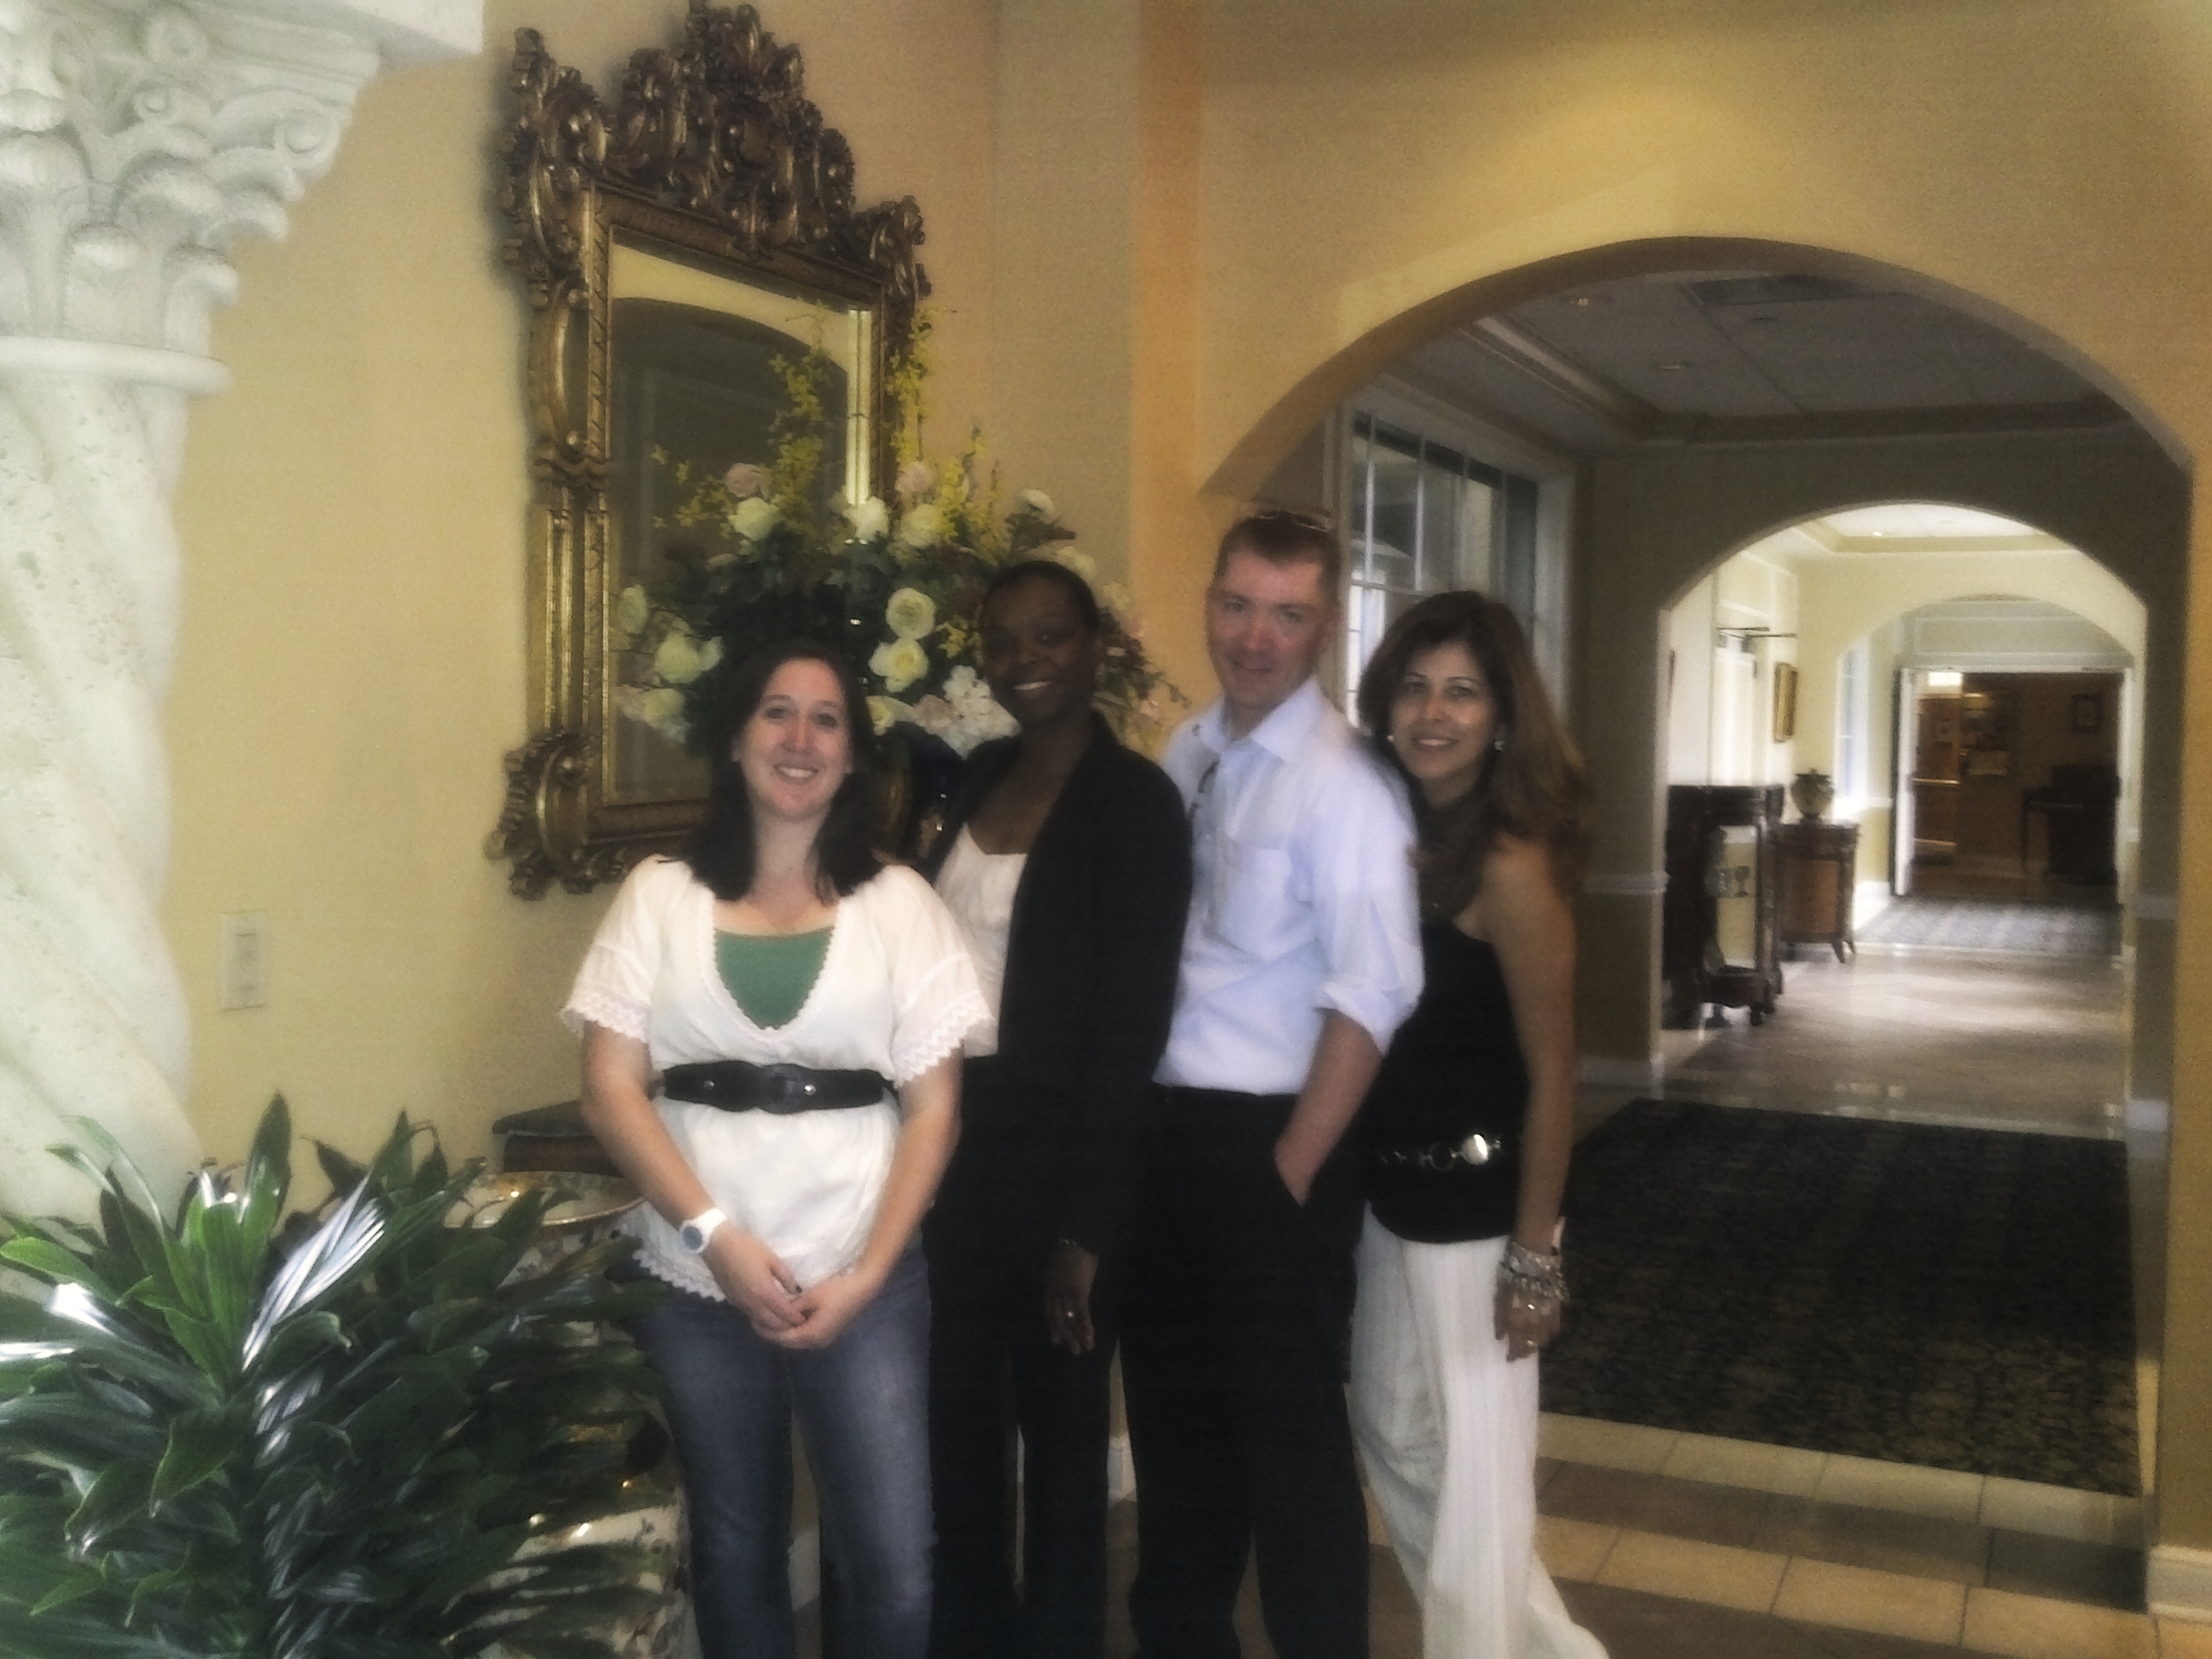
COT Kirklane Elementary
Palm Beach Title I* School
Little Red Schoolhouse
Safety Patrol Trip to Washington, D.C.
2012 Dual Language Spotlight Dance
2013 Dual Language Spotlight Dance
*Consolidated Exceptionalities*
*Departmentalized Instruction*
*Supplemented Strategies
*Administered Assessments
*Managed Safety Patrols
2010-2013
4th Grade Teacher
4th Grade Dual
Language Team

Slide 30
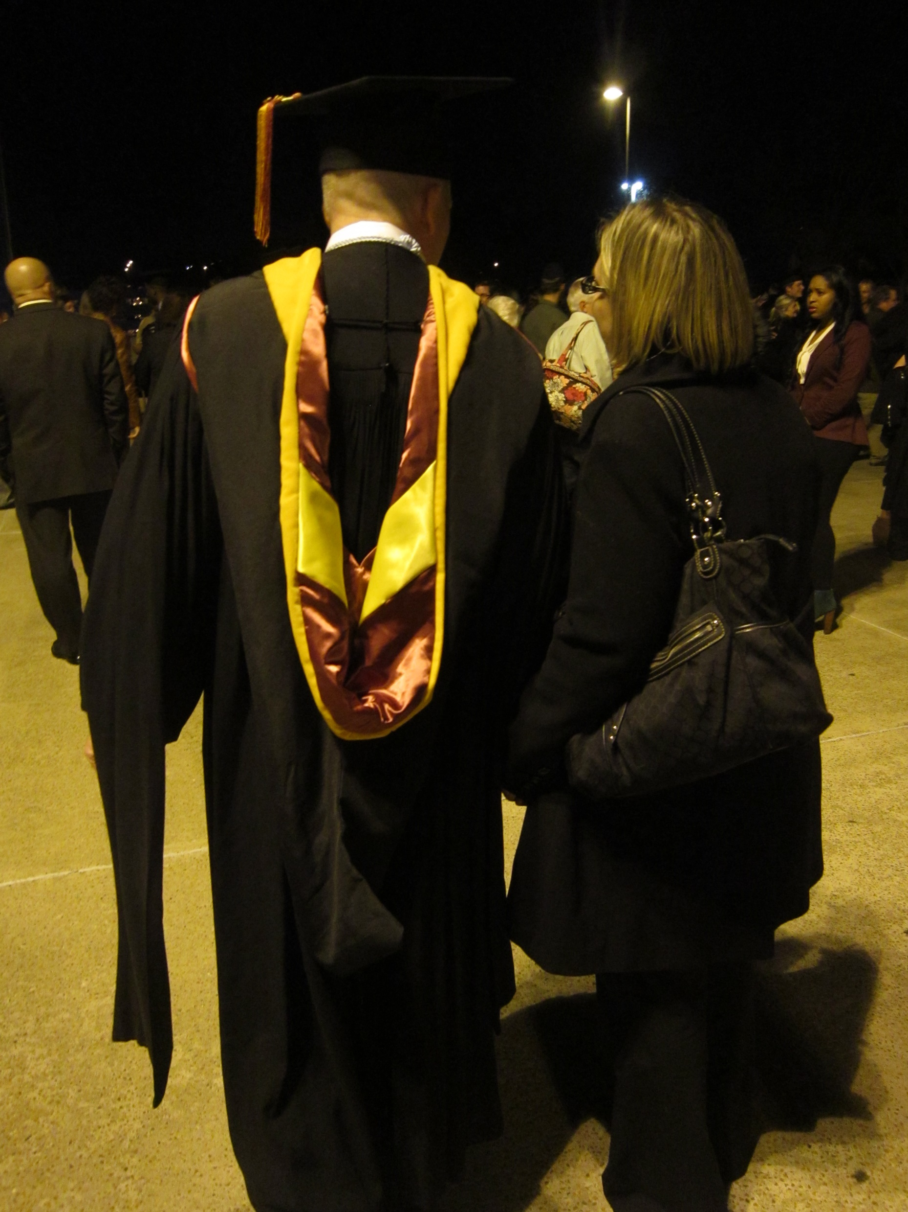
2010-2012 Florida State University Tallahassee, Florida Masters in Library and Information Studies

Slide 31
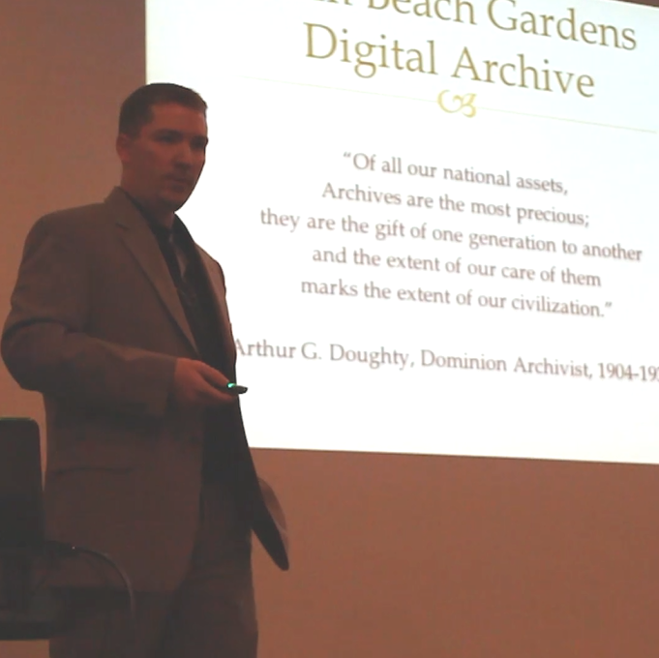
2012-2018
Becoming an Information Professional
Web Designer, HTML/CSS Expert* Government Documents Cataloging
Digital Archiving/Exhibit Development SEO Analysis/Management*
Adjunct Reference Librarian, UCF* Digital Media Specialist

Slide 32
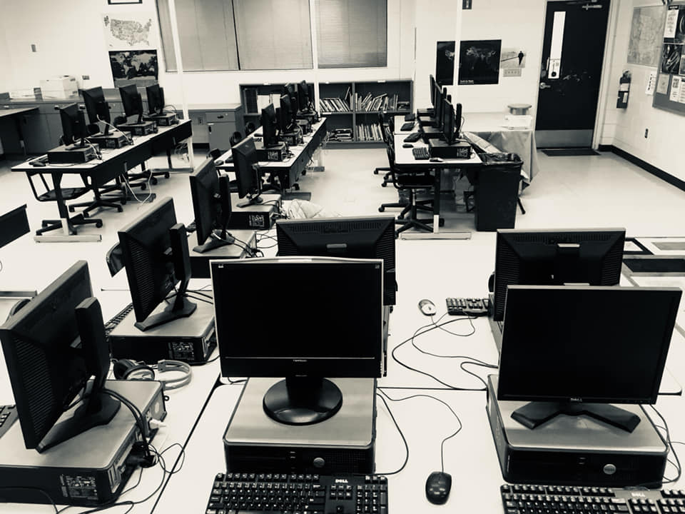
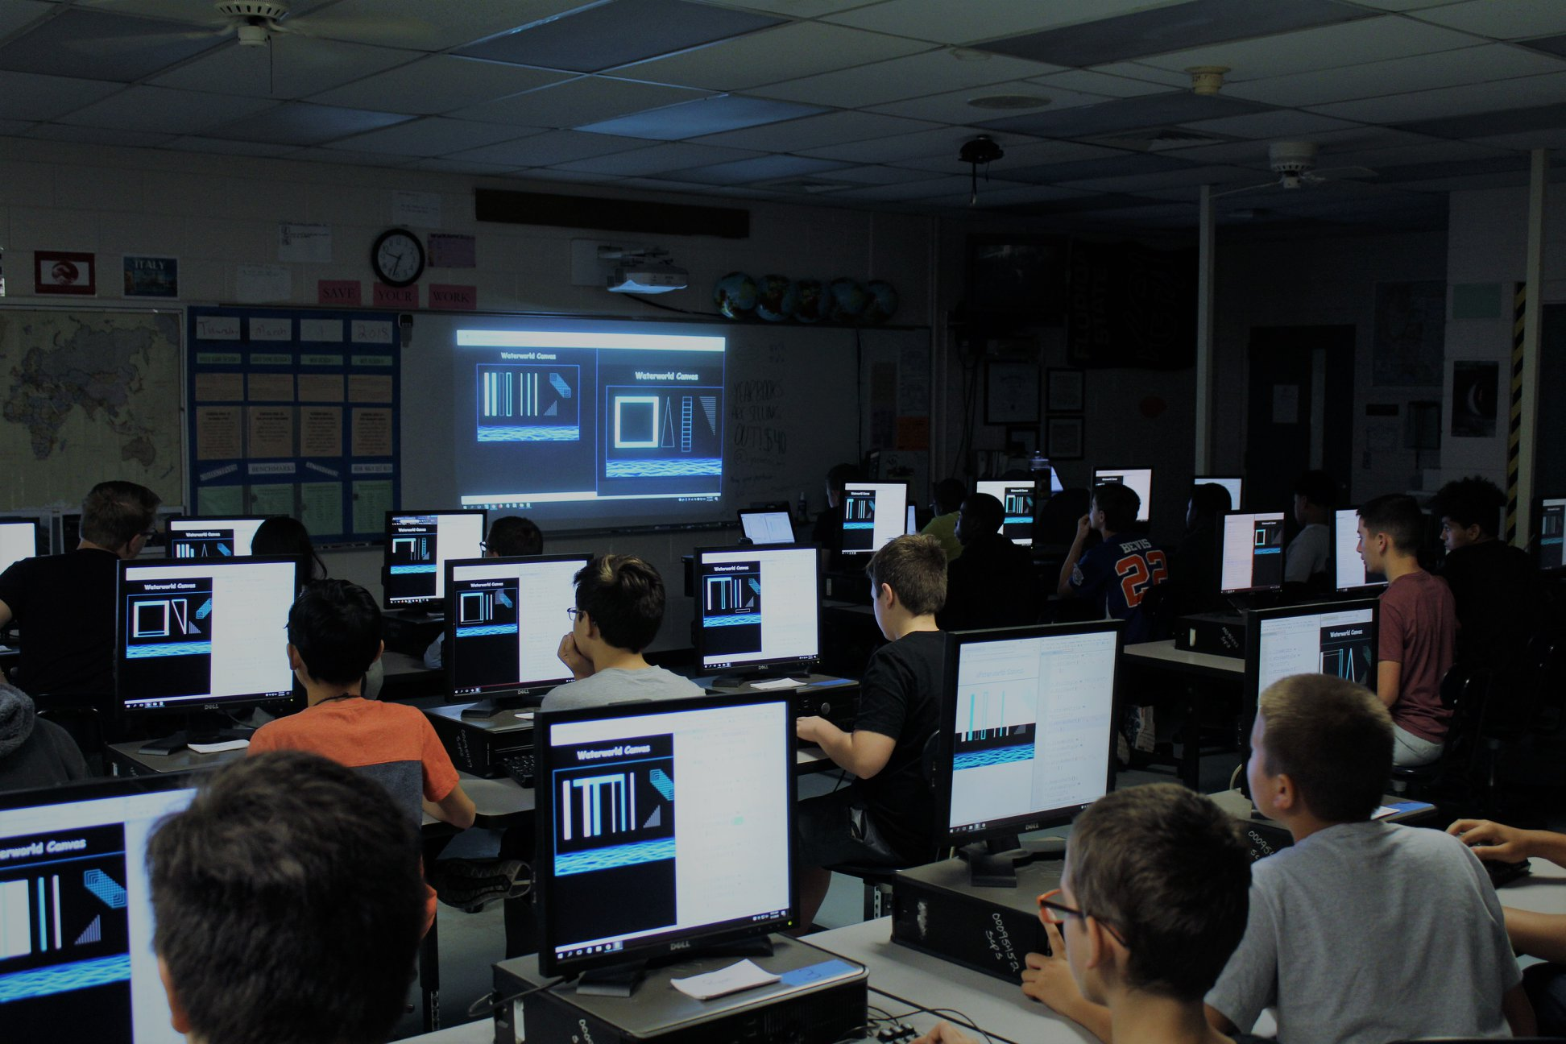
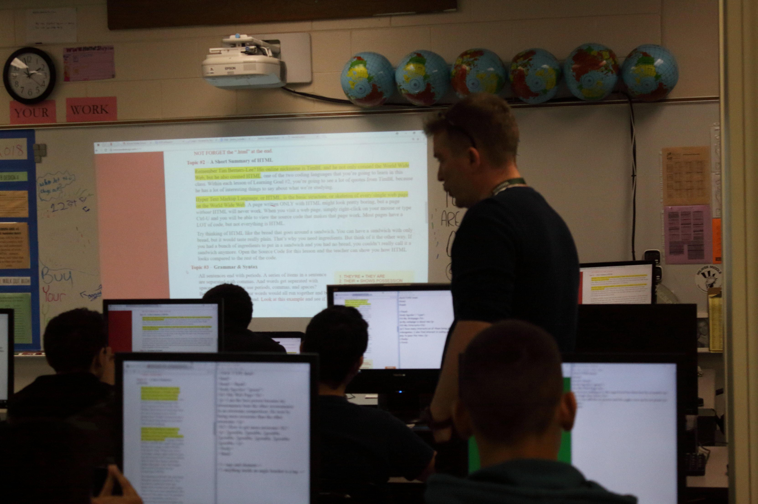
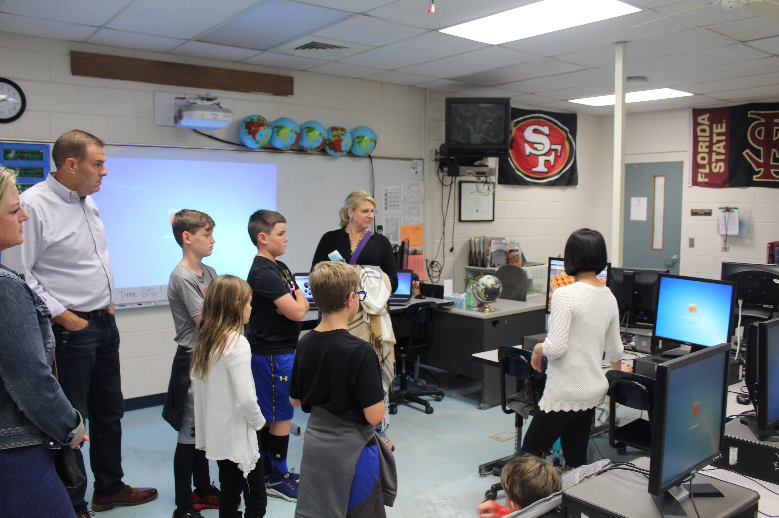
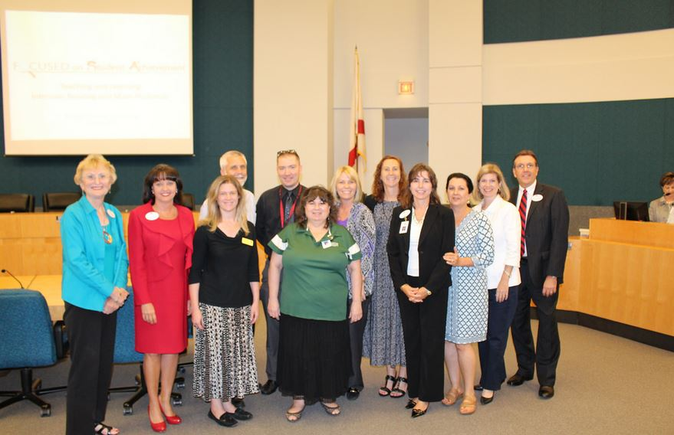
Original Curriculum – HTML/CSS/JavaScript
Milwee Middle School
Seminole County Title I Campus
Programming Lab - 35 Computers
Direct Instruction – Enriching Literacy
Developing Student Leadership*
*Built Three Original Design Courses*
*Revised Content for At-Risk Students
*Collaborated with Relevant Departments
*Coordinated Community Design Projects*
*Administered Assessments/Certifications
*Diversified Presentation of New Material
Presenting to the SCPS Board
2013-2018
Web Design Teacher

Slide 33
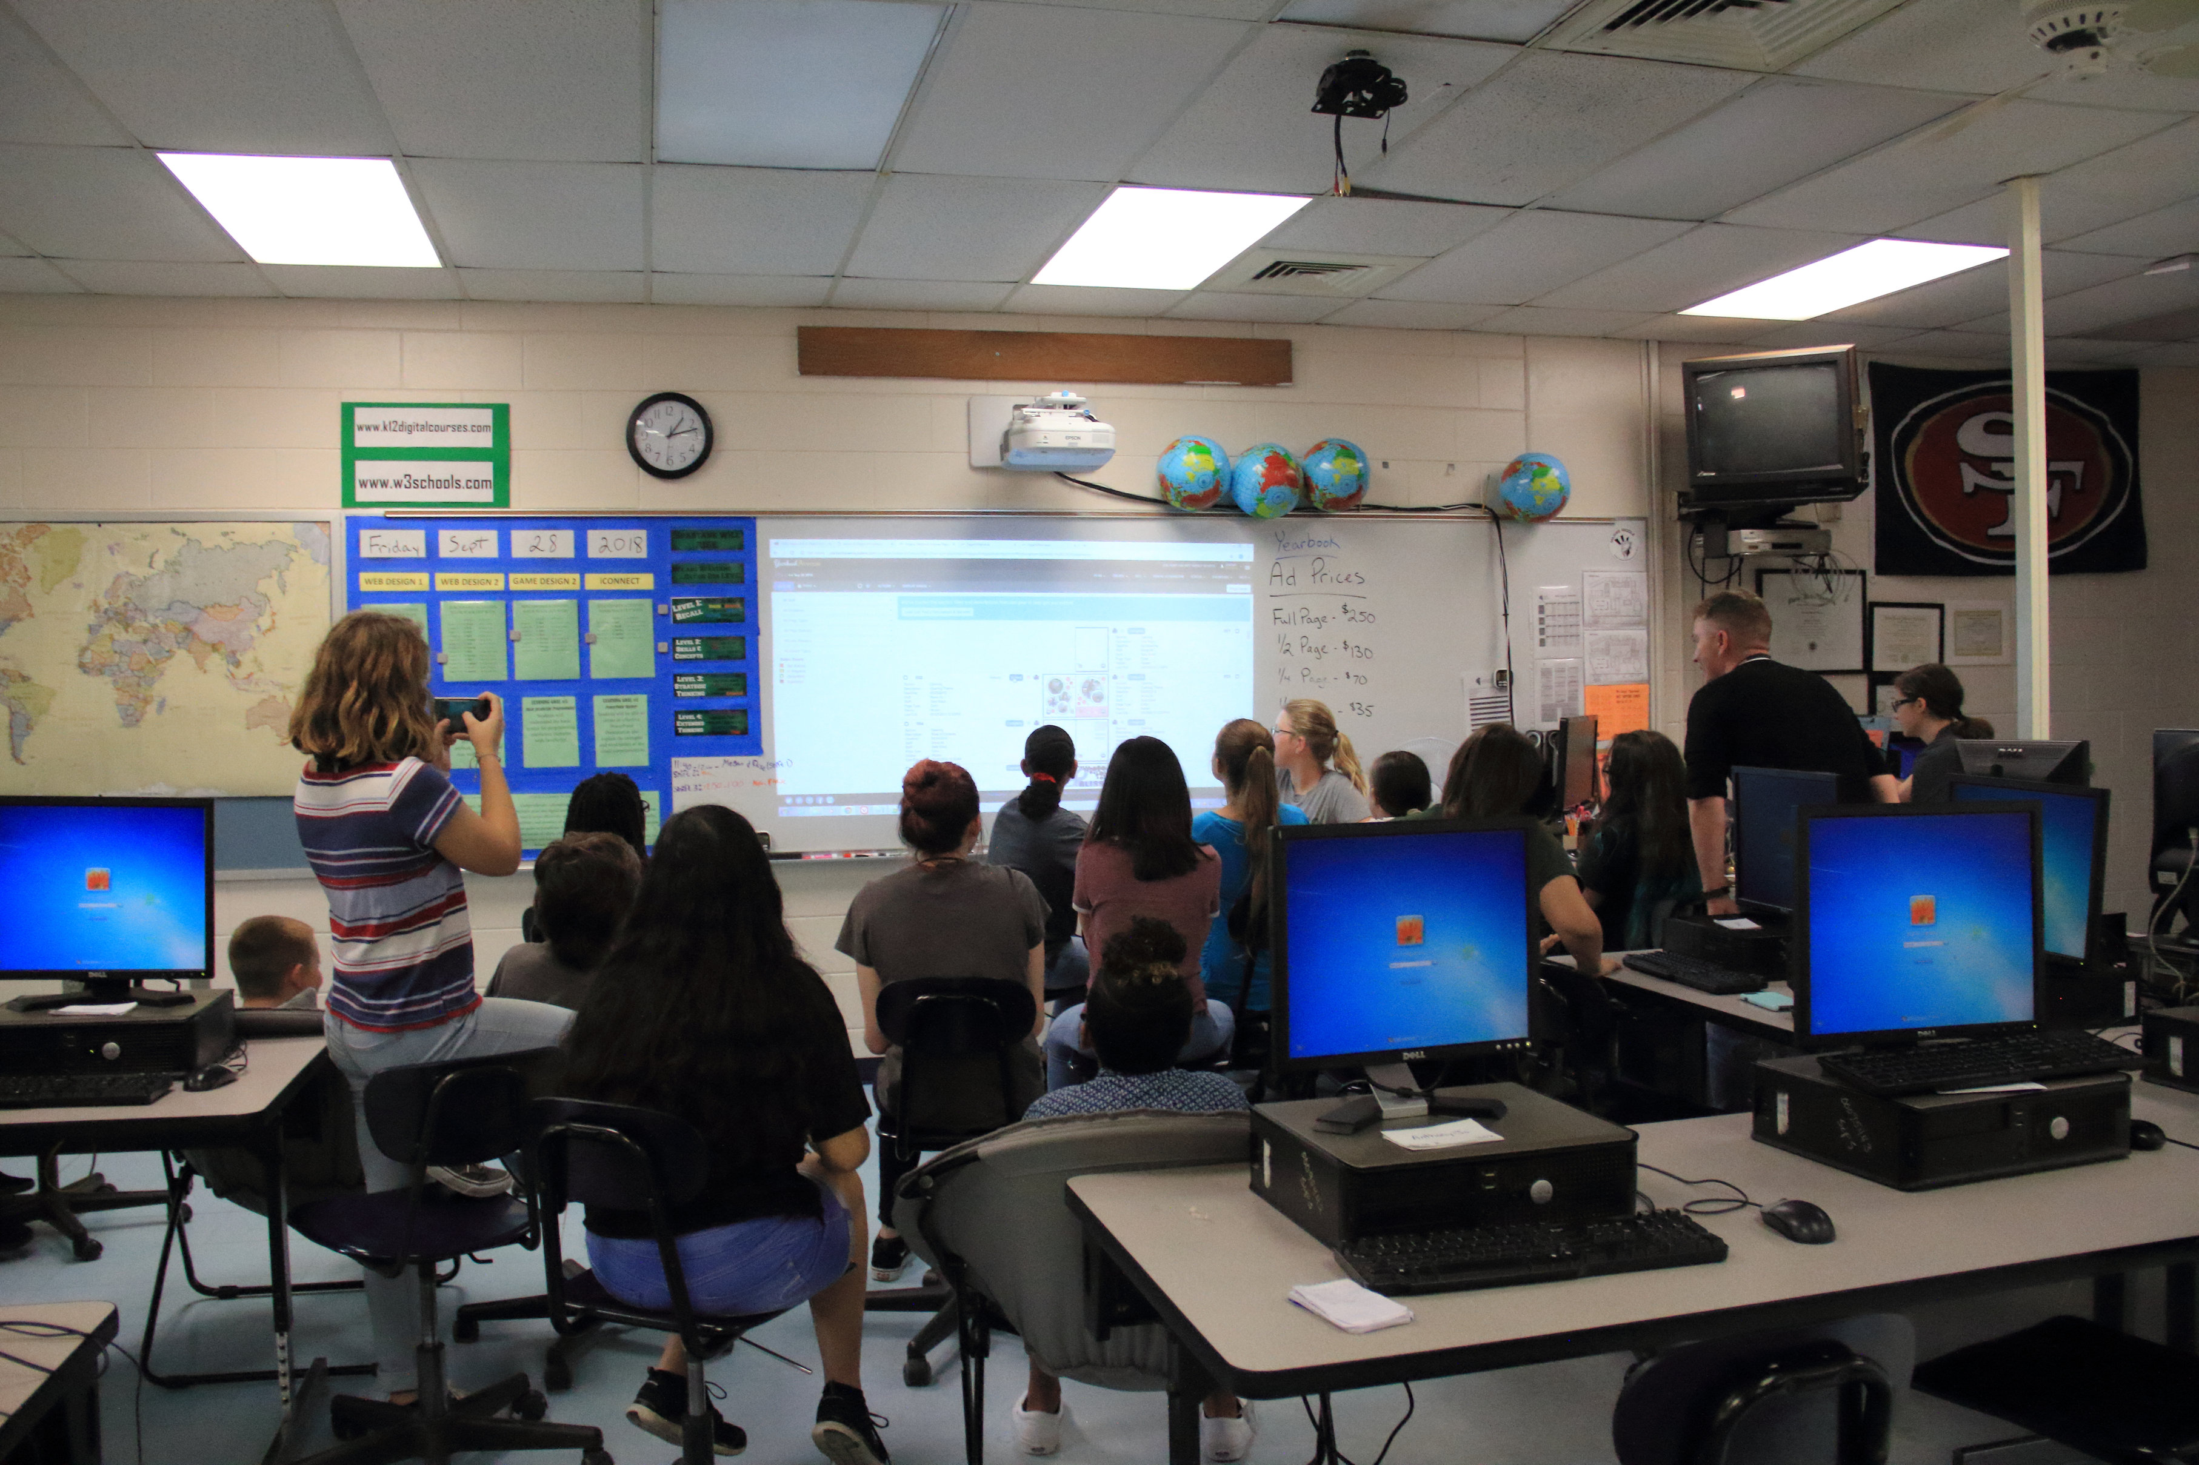
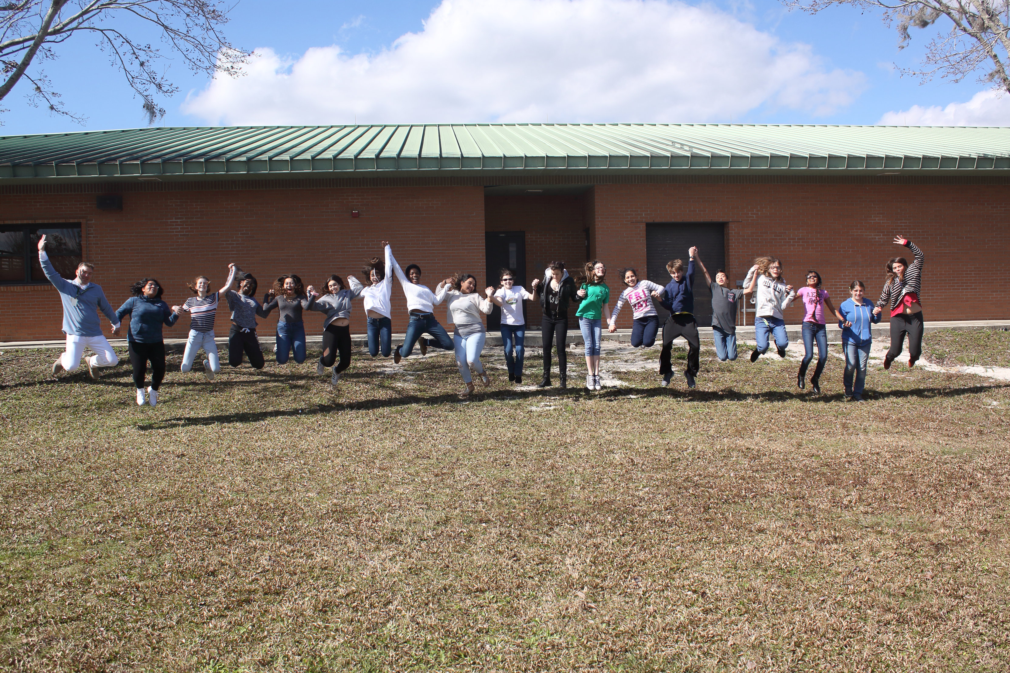
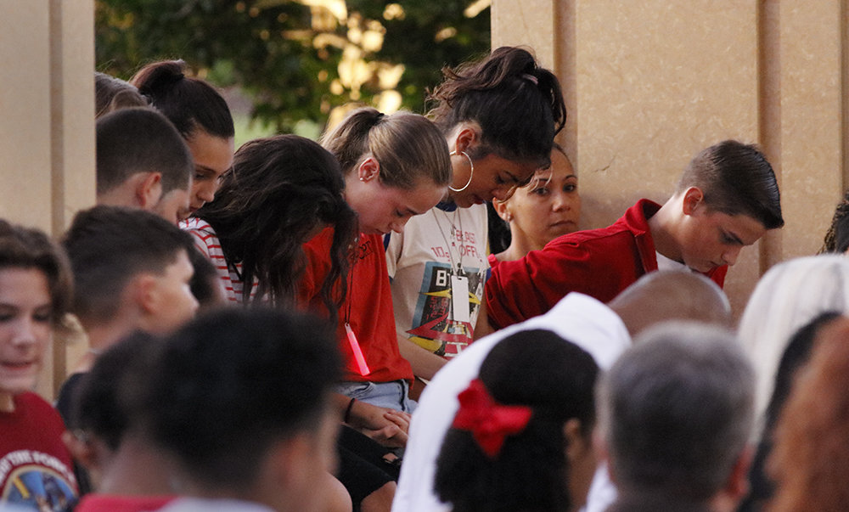
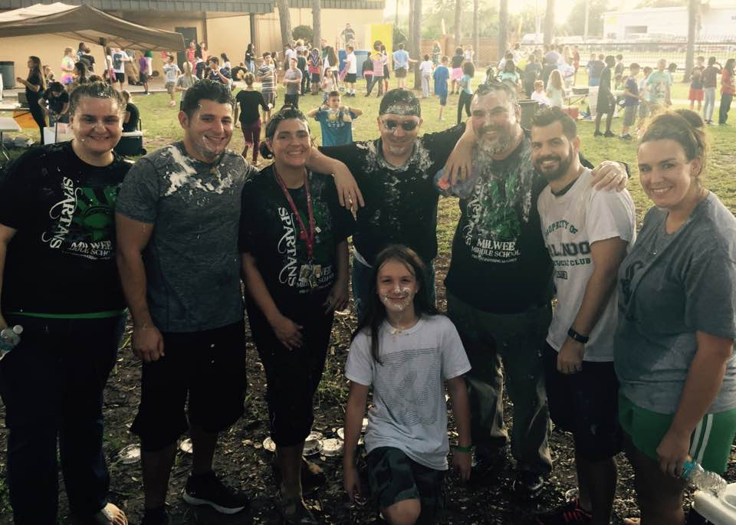
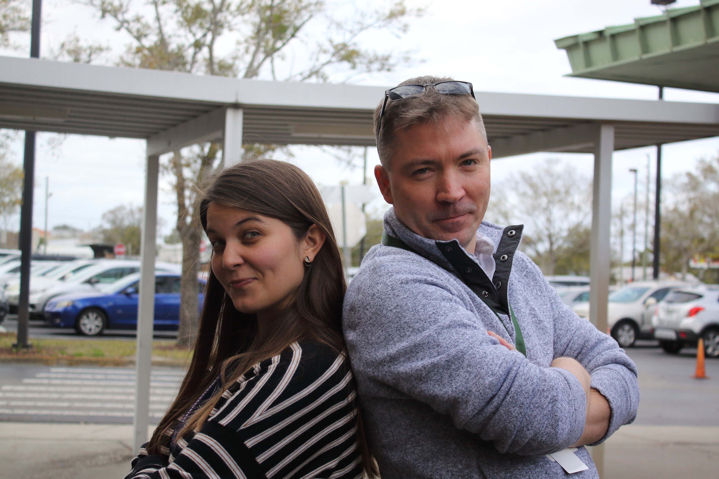
Supervised the Publication of Four Separate
Yearbooks Spanning 120+ Pages*
Gathered Student Input/Feedback*
Celebrated Student Success*
Built Lasting Partnerships and Friendships
Shared Student Burdens*
Lifted Student Spirits
2014-2019
Student Adviser, Teaching Mentor

Slide 34
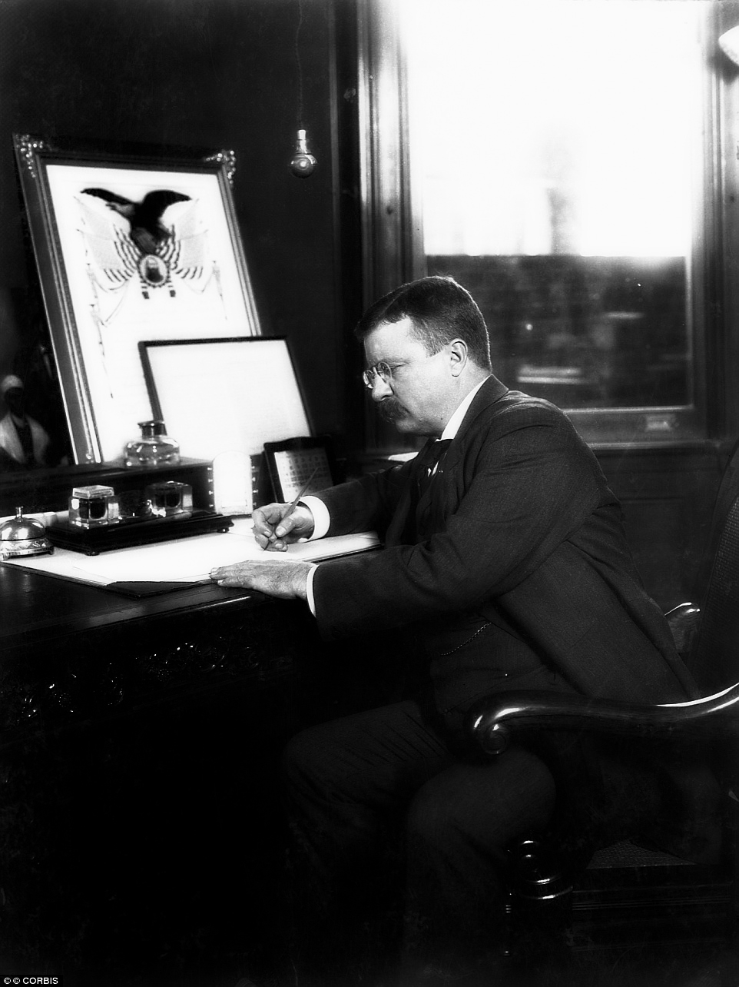
“Every man and woman in the land ought to prize above almost every other quality the capacity for self-help…

Slide 35
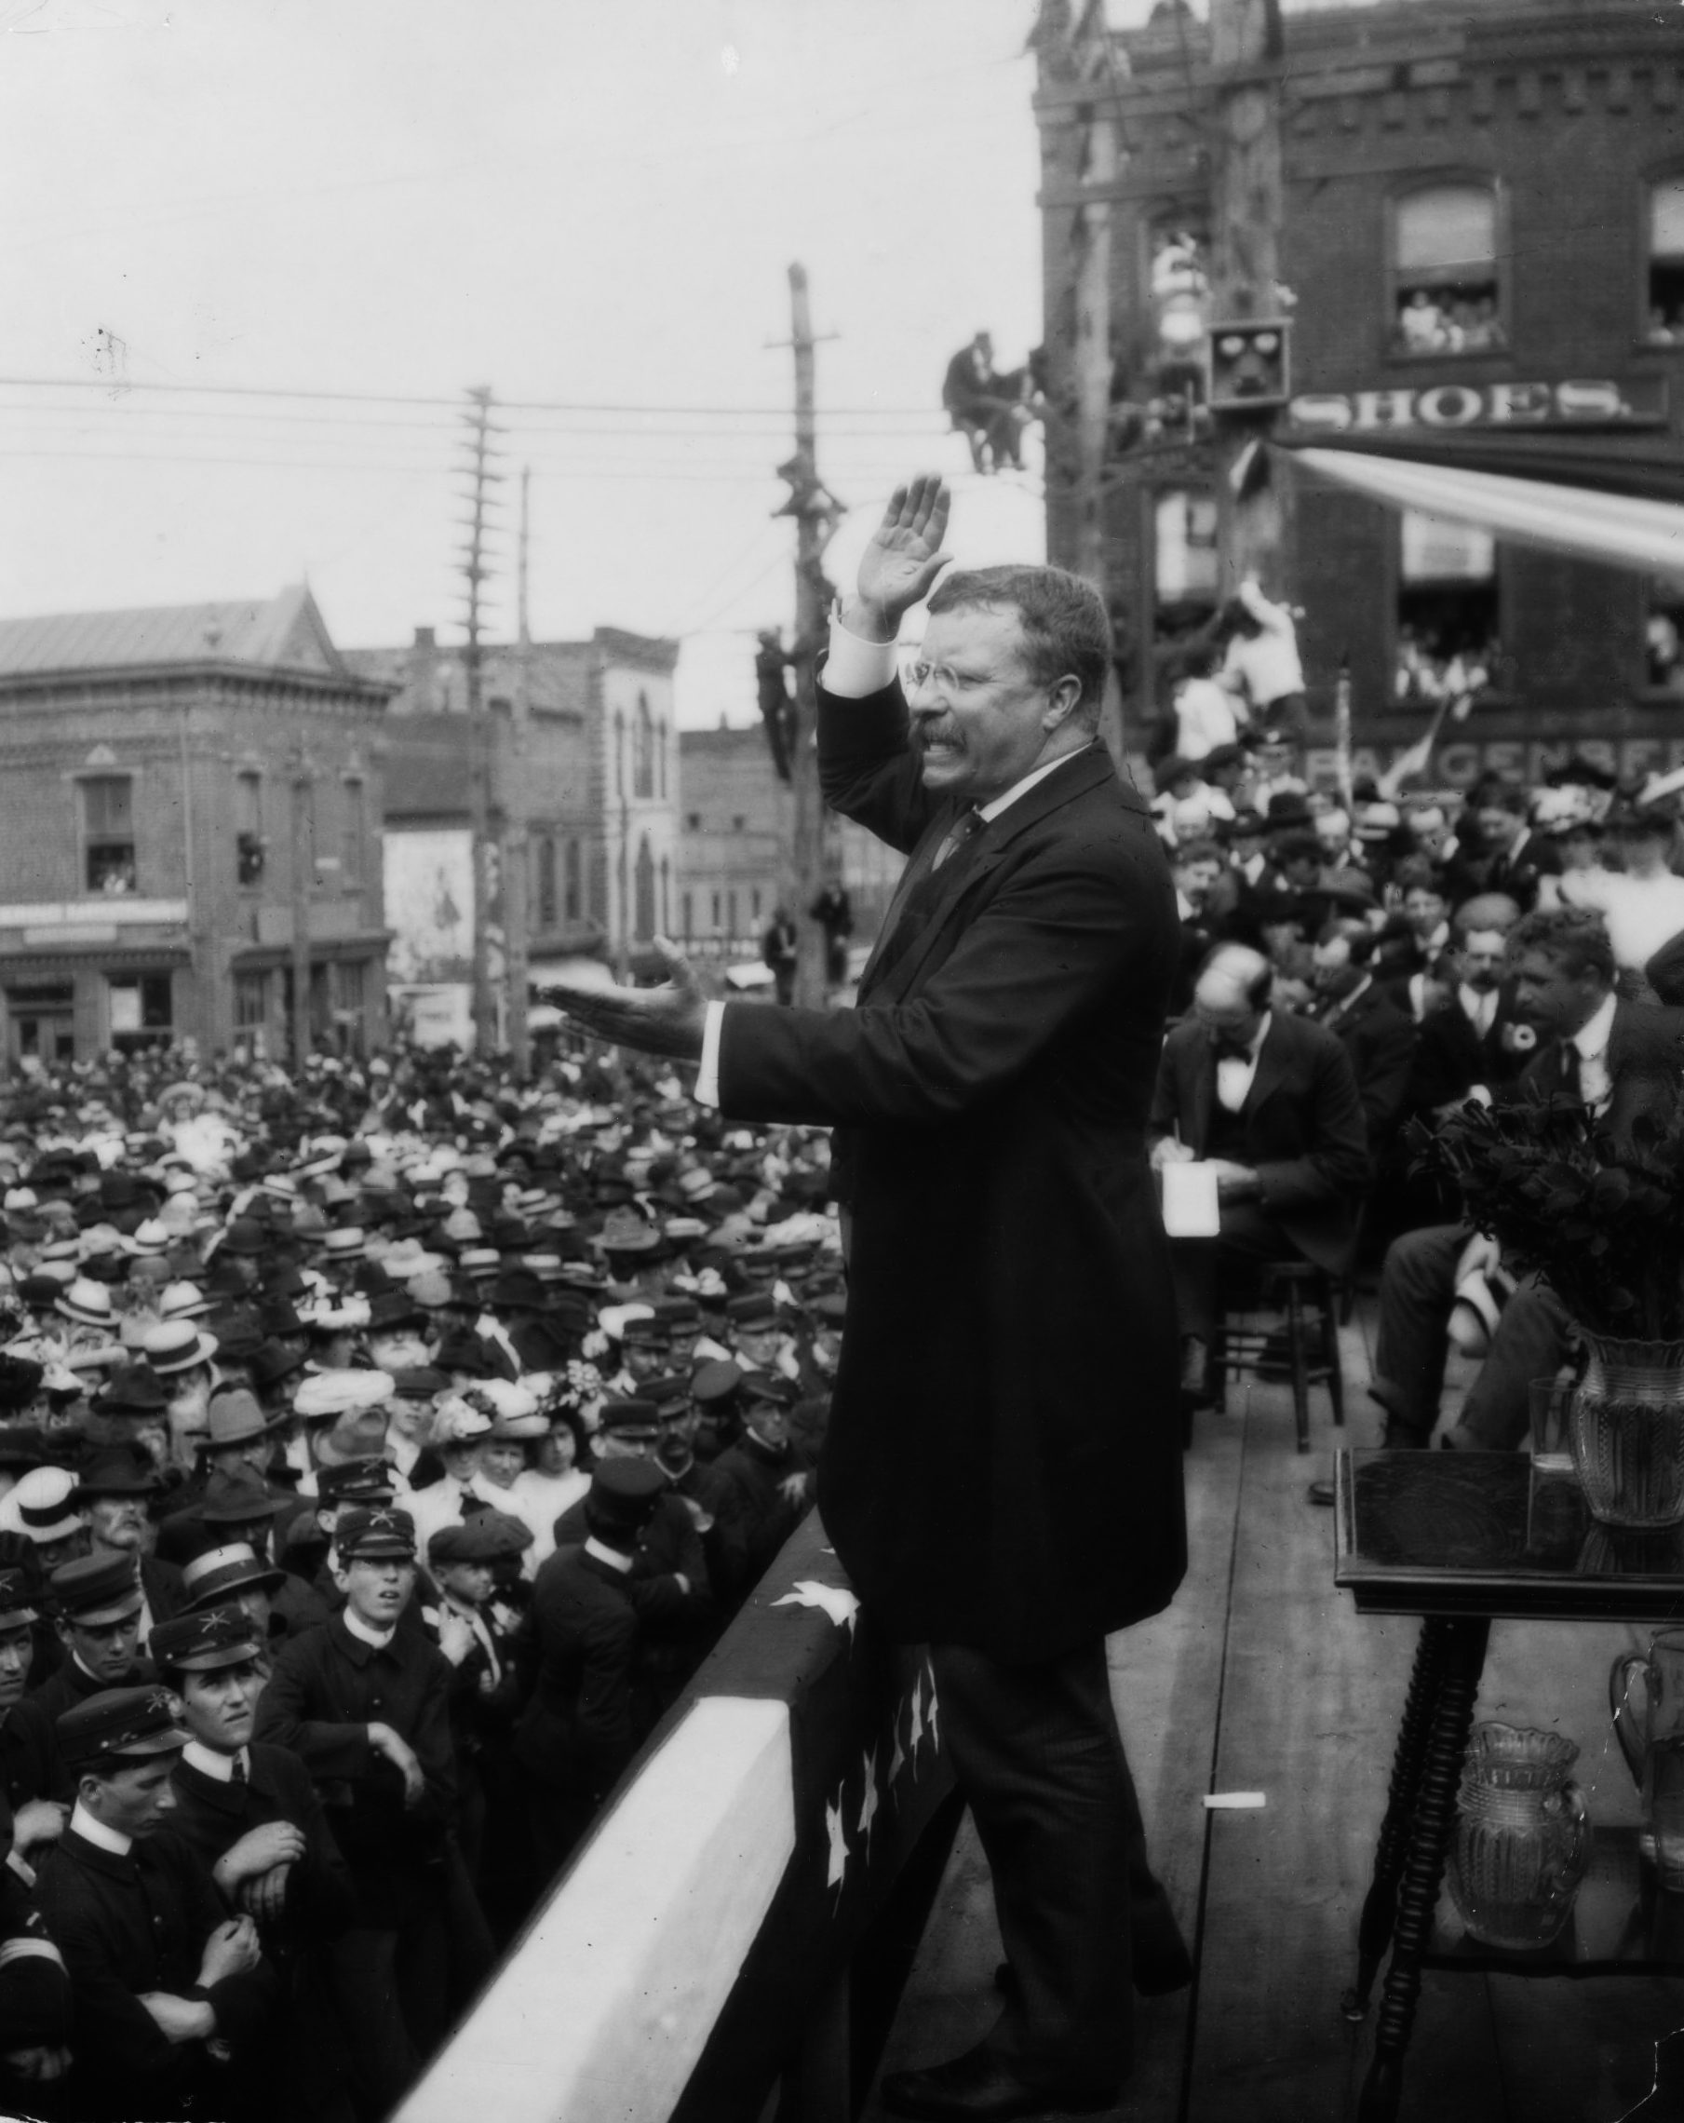
…and yet every man
and woman in the land will at some time or other be sorely in need of the help of others…

Slide 36
…and at some time or other will find that he or she can in turn
give help even to the strongest.”
Teddy Roosevelt, Oct 1900
Civic Helpfulness, Century

Slide 37
AND WELCOME TO 2019 #CHARGEON
THANK YOU FOR YOUR TIME
STUDENT SUCCESS & TEXTBOOK AFFORDABILITY
LIBRARIAN

